Slide 1
A SYSTEM FOR DONATING LEFTOVER FOOD

Slide 2
PROJECT DESCRIPTION
Our project, "System for Donating Leftover Food," is a website designed to facilitate the donation of surplus food from functions, hotels, canteens, and other sources to orphanages, old age homes, and charitable trusts. The platform consolidates various trusts into a single, easy-to-use interface, allowing donors to select a trust and donate leftover food efficiently. This system helps reduce food waste while supporting trusts by saving on the cost and effort of preparing one-time meals

Slide 3
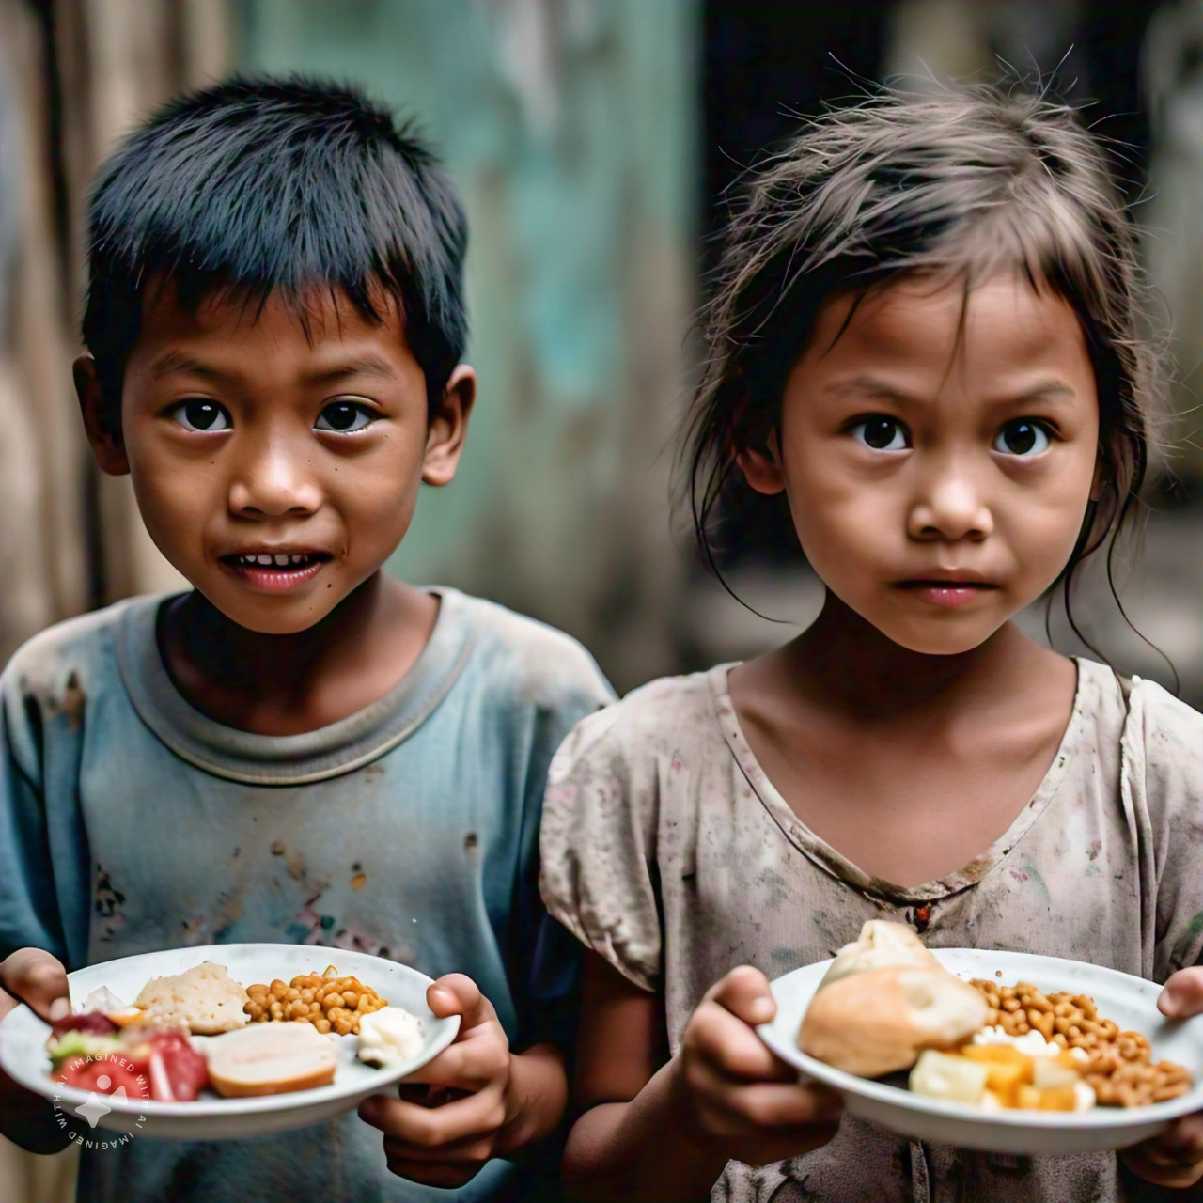

Slide 4
Your project can be categorized under the following themes in Smart India Hackathon (SIH):
1. Waste Management and Recycling: As your project aims to reduce food waste by collecting leftovers and distributing them to homeless individuals and dogs.
2. Social Impact: As your project focuses on helping homeless people and dogs, addressing social issues like hunger and food insecurity.
3. Health and Hygiene: As your project involves reporting unclean or undisciplined food practices in hotels and alerting food officers to take action, ensuring food safety and hygiene
4. Animal Welfare: As your project includes providing food for pets, addressing animal welfare and care. Choose the primary category that aligns best with your project's core objective. If needed, you can also mention secondary categories to highlight the project's multifaceted approach

Slide 5
PROBLEM STATEMENT
Food waste statistics
1/3 of all food produced globally is lost or wasted
40% of food waste occurs in the supply chain
Homelessness statistics
150 million people worldwide are homeless
25% of homeless individuals suffer from hunger
Impact of food waste on environment and society
Greenhouse gas emissions
Water waste
Economic losses

Slide 6
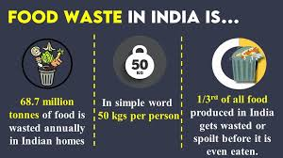

Slide 7


Slide 8
SOLUTION OVERVIEW
Food collection from:
Mess (hostels, canteens) - Hotels - Functions (events, parties) - Donations
Food distribution to homeless shelters and individuals
Reporting system for:
Complaining about hotels with unclean or undisciplined
Food practices :
Alerting food officers to take action

Slide 9
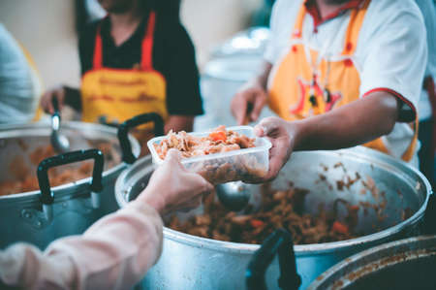

Slide 10


Slide 11
CONCLUSION
Food Rescue aims to make a positive impact on food waste and homelessness
Join us in this initiative to create a better community!

